Slide 1
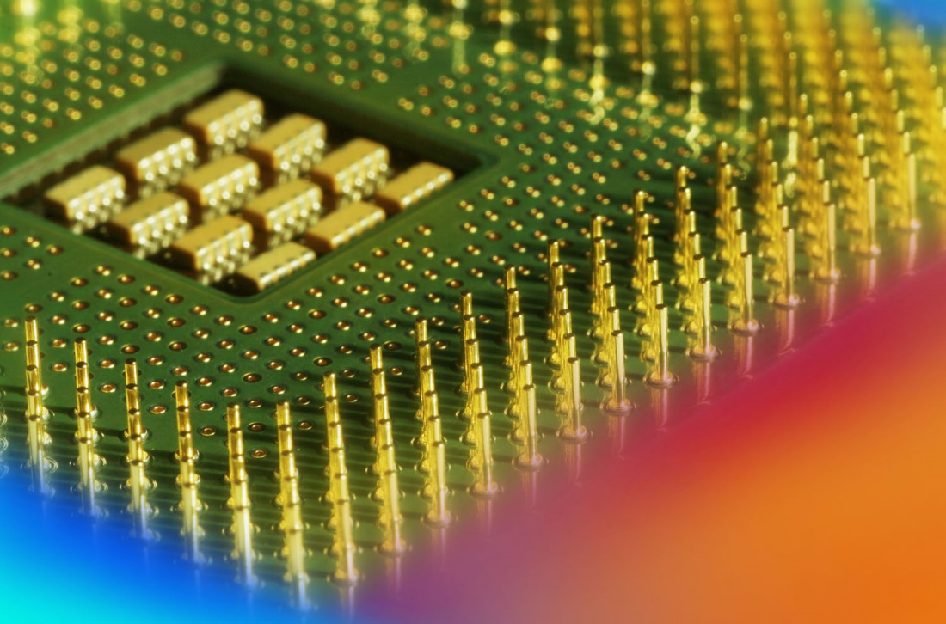
Digital Fundamentals
Tenth Edition
Floyd
BCD Code
© 2008 Pearson Education

Slide 2
THE 8421 BCD CODE
BCD stands for Binary-Coded Decimal.
A BCD number is a four-bit binary group that represents one of the ten decimal digits 0 through 9.
Example:
Decimal number 4926 4 9 2 6
8421 BCD coded number 0100 1001 0010 0110

Slide 3
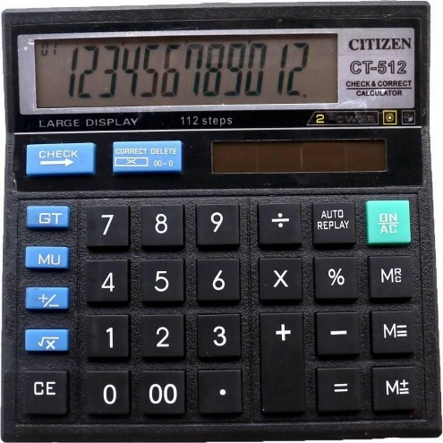
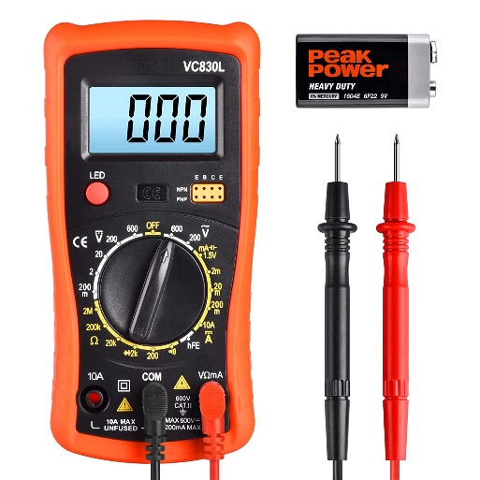
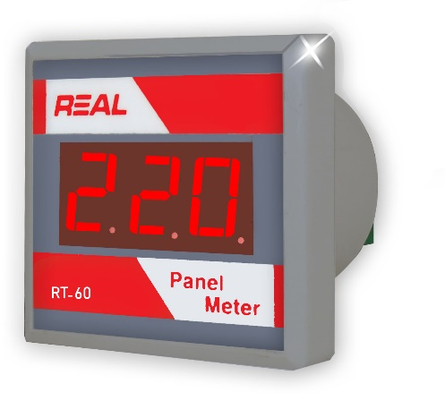
THE 8421 BCD CODE
BCD stands for Binary-Coded Decimal.
BCD use in

Slide 4
THE 8421 BCD CODE
Convert the decimal number 350 to its BCD equivalent.
Decimal Number 3 5 0
BCD Coded Number 0011 0101 0000

Slide 5
THE 8421 BCD CODE
Convert the BCD coded number
1000 0111 0001 into decimal.
BCD Coded Number 1000 0111 0001
Decimal Number 8 7 1

Slide 6
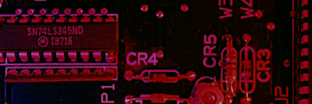
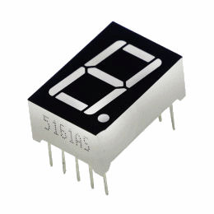
Summary
7 Segment Display
A standard 7-segment LED display generally has eight (8) input connections, one for each LED segment and one that acts as a common terminal or connection for all the internal display segments. Some single displays have also have an additional input pin to display a decimal point in their lower right or left hand corner.

Slide 7
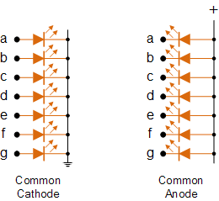
Summary
Types of 7 Segment Display
In electronics there are two important types of 7-segment LED digital display.
1. The Common Cathode Display (CCD) – In the common cathode display, all the cathode connections of the LED’s are joined together to logic “0” or ground. The individual segments are illuminated by application of a “HIGH”, logic “1” signal to the individual Anode terminals.

Slide 8
Summary
Types of 7 Segment Display
In electronics there are two important types of 7-segment LED digital display.
2. The Common Anode Display (CAD) – In the common anode display, all the anode connections of the LED’s are joined together to logic “1” + and the individual segments are illuminated by connecting the individual Cathode terminals to a “LOW”, logic “0” signal.

Slide 9
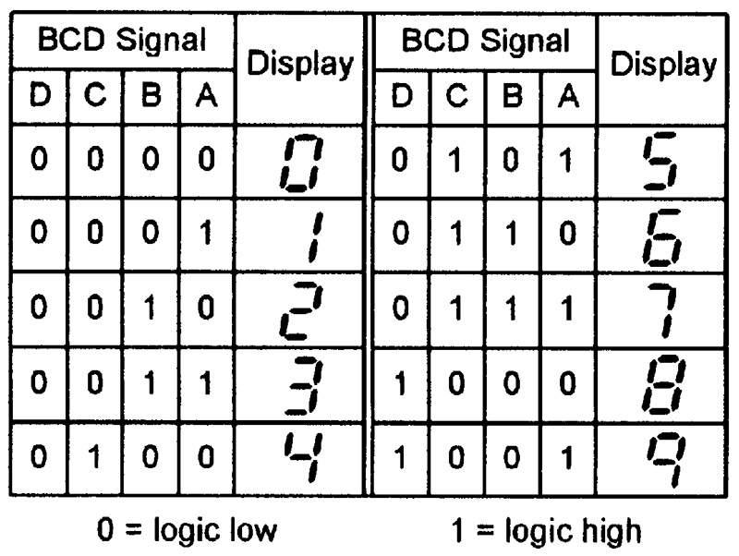
Summary
BCD signals and the displayed seven-segment numerals.

Slide 10
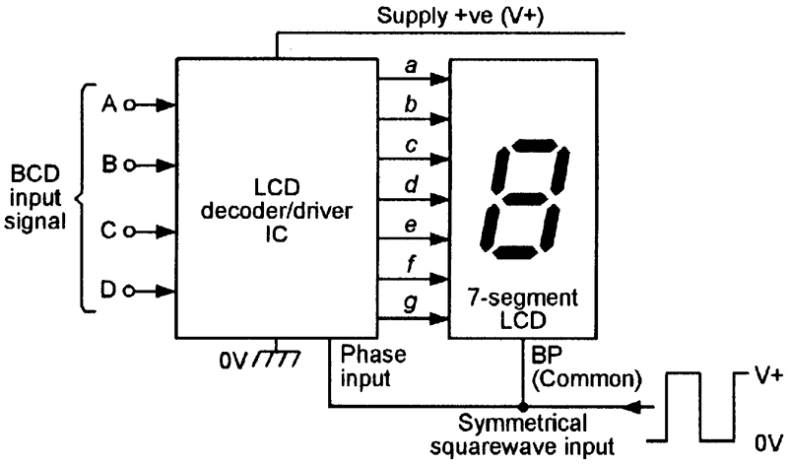
Summary
BCD signals and the displayed seven-segment numerals.

Slide 11
Summary
Encoding
In Binary Coded Decimal (BCD) encoding scheme each of the decimal numbers(0-9) is represented by its equivalent binary pattern(which is generally of 4-bits).

Slide 12
Summary
Encoding
Whereas, Seven segment display is an electronic device which consists of seven Light Emitting Diodes (LEDs) arranged in a some definite pattern (common cathode or common anode type), which is used to display numerals(in this case decimal numbers, as input is BCD i.e., 0-9).

Slide 13
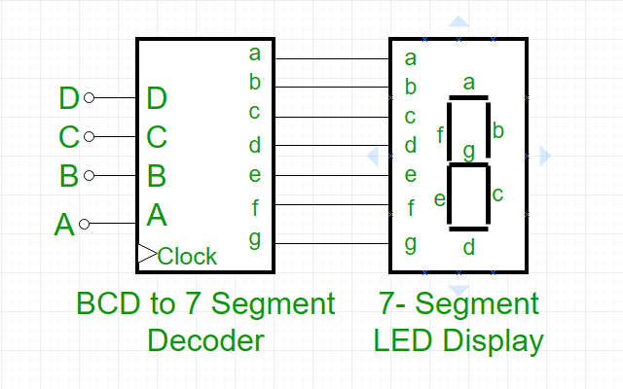
Summary
Decoding
The seven segment display does not work by directly supplying voltage to different segments of LEDs.
First, our decimal number is changed to its BCD equivalent signal then BCD to seven segment decoder converts that signals to the form which is fed to seven segment display.

Slide 14
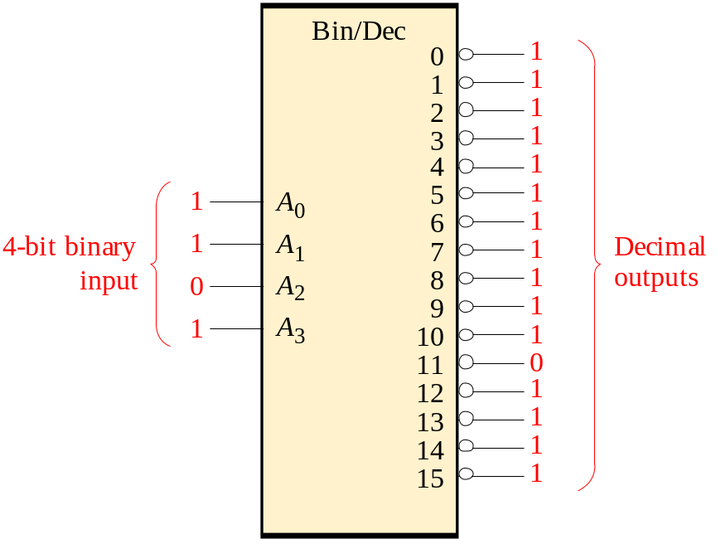

Summary
Decoders
IC decoders have multiple outputs to decode any combination of inputs. For example the binary-to-decimal decoder shown here has 16 outputs – one for each combination of binary inputs.
Question
For the input shown, what is the output?

Slide 15
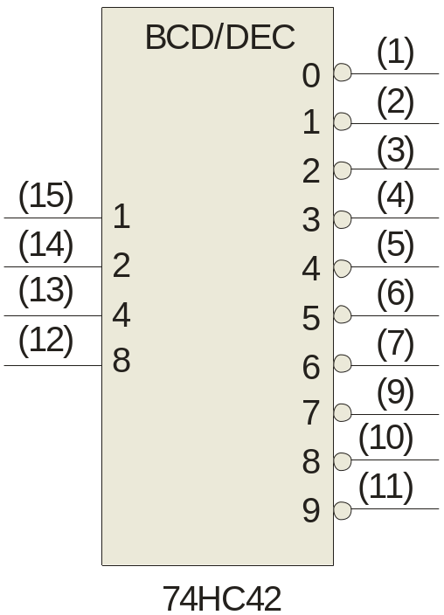

Summary
Decoders
BCD-to-decimal decoders accept a binary coded decimal input and activate one of ten possible decimal digit indications.
A₀
A₁
A₂
A₃
Example
Assume the inputs to the 74HC42 decoder are the sequence 0101, 0110, 0011, and 0010. Describe the output.
Solution
All lines are HIGH except for one active output, which is LOW. The active outputs are 5, 6, 3, and 2 in that order.

Slide 16
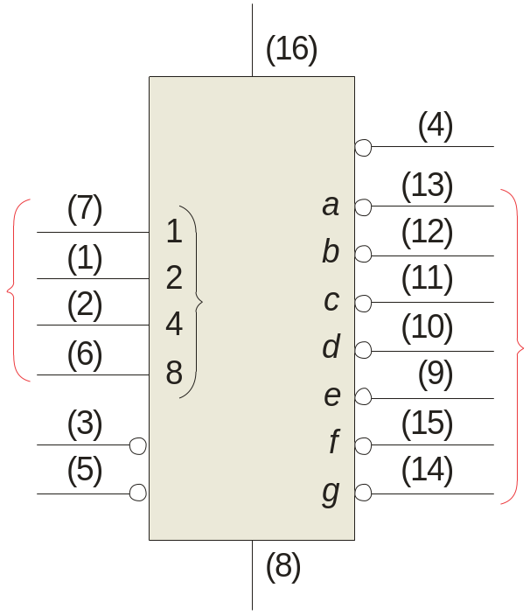
Summary
BCD Decoder/Driver
Another useful decoder is the 74LS47. This is a BCD-to-seven segment display with active LOW outputs.
V_{CC}
The a-g outputs are designed for much higher current than most devices (hence the word driver in the name).
BCD/7-seg
BI/RBO
BI/RBO
BCD inputs
Outputs to seven segment device
LT
LT
RBI
RBI
74LS47
GND

Slide 17
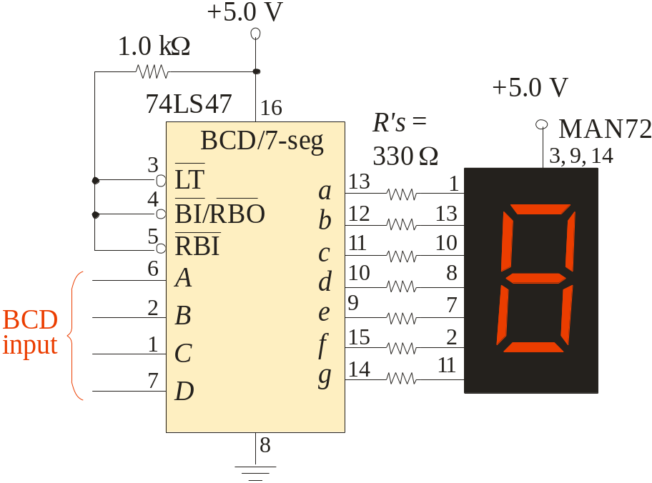
Summary
BCD Decoder/Driver
Here the 7447A is an connected to an LED seven segment display. Notice the current limiting resistors, required to prevent overdriving the LED display.

Slide 18
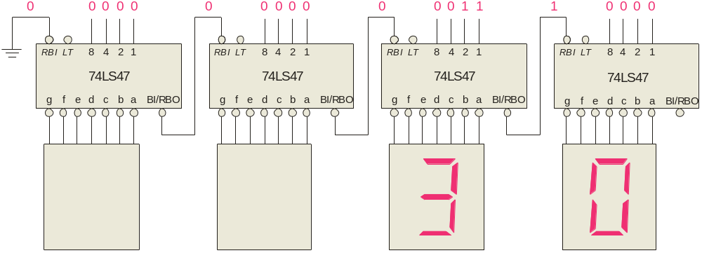
Summary
BCD Decoder/Driver
The 74LS47 features leading zero suppression, which blanks unnecessary leading zeros but keeps significant zeros as illustrated here. The BI/RBO output is connected to the RBI input of the next decoder.
Blanked
Blanked
Depending on the display type, current limiting resistors may be required.

Slide 19
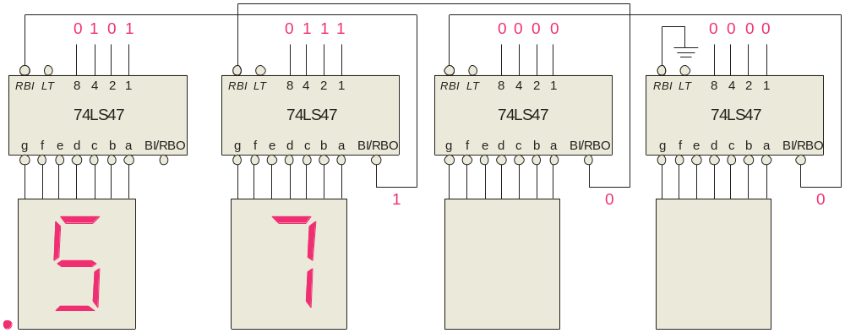
Summary
BCD Decoder/Driver
Trailing zero suppression blanks unnecessary trailing zeros to the right of the decimal point as illustrated here. The RBI input is connected to the BI/RBO output of the following decoder.
Decimal point
Blanked
Blanked

Slide 20
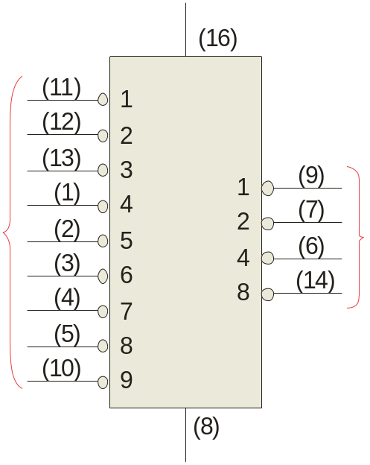
Summary
Encoders
The 74HC147 is an example of an IC encoder. It is has ten active-LOW inputs and converts the active input to an active-LOW BCD output.
V_{CC}
This device is offers additional flexibility in that it is a priority encoder. This means that if more than one input is active, the one with the highest order decimal digit will be active.
HPRI/BCD
Decimal input
BCD output
74HC147
The next slide shows an application …
GND

